Slide 1
Literature Review
VI-SLAM comparison
Detailed Study of VINS-Mono
Temporal coherence between IMU and Camera
Ritvik Pandey
Intern H402743

Slide 2
Overview
VIO techniques
VINS-Mono: Intro
Pre-processing
Initialization
VIO algorithm
Relocalization and Global pose graph optimization
Temporal calib

Slide 3
Overview
VIO techniques
VINS-Mono: Intro
Pre-processing
Initialization
VIO algorithm
Relocalization and Global pose graph optimization
Temporal calib
What is SLAM, VIO, why is it needed, minimum setup, our PS
Various other VIOs available in market, classification and techniques
What is VINS-Mono, what category it falls into, global v/s local problem, overview of its working and applications
Its need, Visual pre-processing and IMU-preintegration, formulations
Why initialization crucial, mathematical formulations
Core-VIO algorithm, what are considerations and optimizations parameters
Why relocalization, how does it happen,
difference between relocalization and global pose graph optimization, optimization for relocalization, global pose graph structure, optimization for pose graph optimization
Why is it needed, process, tweaks to be made

Slide 4
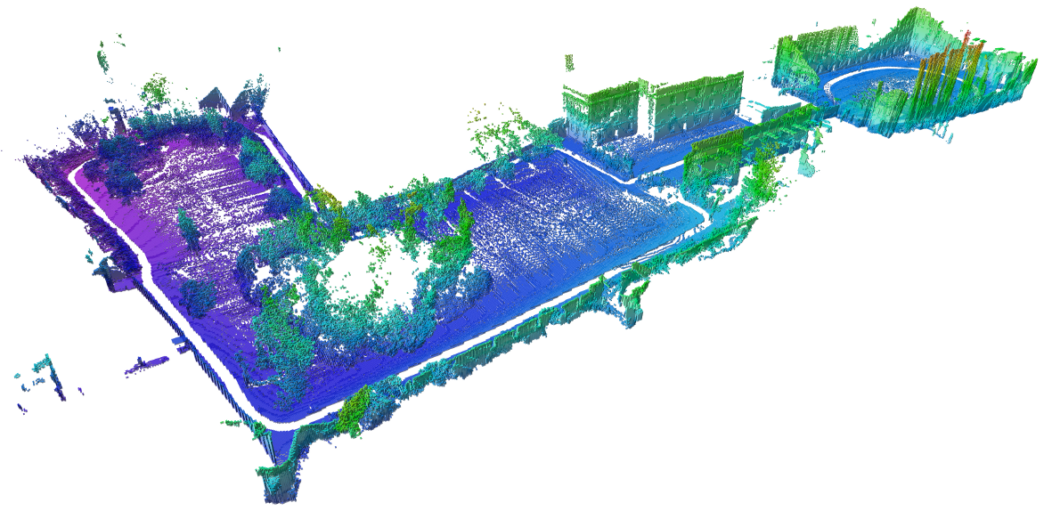
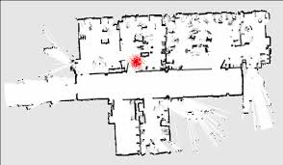
Overview
VIO techniques
VINS-Mono: Intro
Pre-processing
Initialization
VIO algorithm
Relocalization and Global pose graph optimization
Temporal calib
Overview: SLAM
SLAM: Simultaneous Localization and Mapping
Mapping
Localization
What does the world look like
Where am I?
Requires access to observe and recognize landmarks (camera, lidar)
Requires good odometry data (where and how much it has moved)

Slide 5
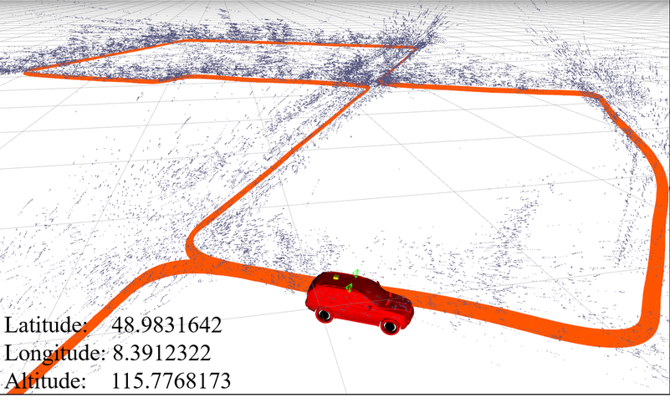
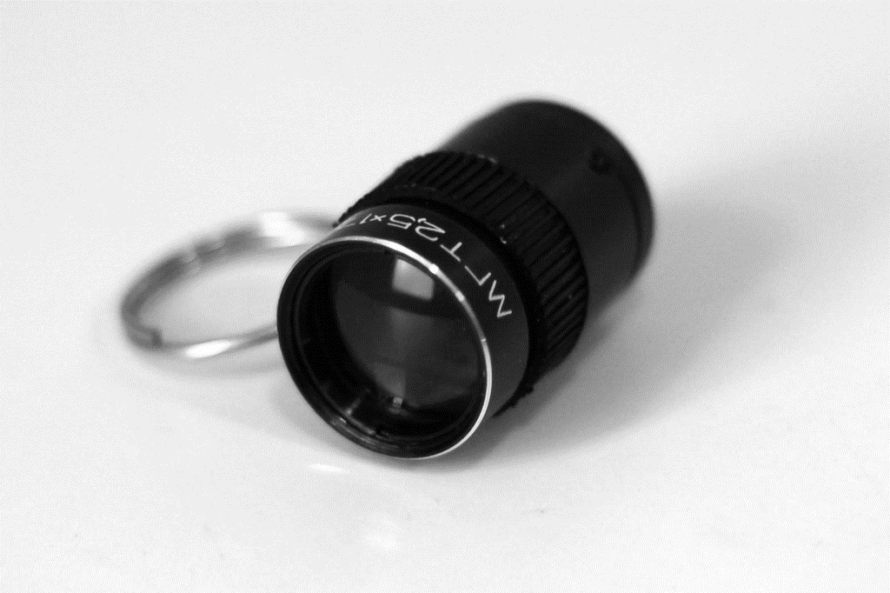
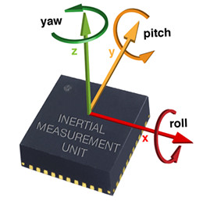
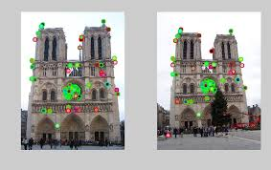
Overview
VIO techniques
VINS-Mono: Intro
Pre-processing
Initialization
VIO algorithm
Relocalization and Global pose graph optimization
Temporal calib
Overview: SLAM
Sensors
Data from sensors such as camera, IMU, lidar is used
Feature match
Relation between current and previous frame is established to keep track of intermediate motion
Pose estimation
Set of these intermediate motions are then used to locate the drone in global frame
Loop closure
Detection of previously visited area to reconfigure estimates
Bundle Adjustment
Local and Global data is adjusted again based on reconfigured values in bundle form

Slide 6
Overview
VIO techniques
VINS-Mono: Intro
Pre-processing
Initialization
VIO algorithm
Relocalization and Global pose graph optimization
Temporal calib
Overview: VI-SLAM
VI-SLAM: Visual-Inertial SLAM (VIO + Visual feature tracking)
Technique to perform SLAM using only visual and inertial data
Visual data
Inertial data
Monocular/Stereo camera
IMU measurements
Has very less chances of error as drone is physically present there but lacks scale measurement
Has significant error associated with it in form of bias but gives scale
Challenges
How to integrate visual and inertial data
How to compensate for time delay in receiving the data
How to deal with old data and large deviations
Minimize computation to make it real-time
What if we loose track of where we are
How to detect and correct our estimates if we visit a place again

Slide 7
Overview
VIO techniques
VINS-Mono: Intro
Pre-processing
Initialization
VIO algorithm
Relocalization and Global pose graph optimization
Temporal calib
VIO: Classification
Broadly, VIO techniques are classified into 2 categories based on how we integrate camera and IMU data
Filtering based
Optimization based
IMU to assist visual-only SLAM
Error from both IMU and visual data is jointly minimized
Comprises of all the techniques which use some kind of filtering algorithm like
EKF (extended Kalman filter for non-linear problems)
Ellipsoidal Kalman filter
Dynamic Linear model
We calculate error from tracking of features of visual data and IMU data error to match with it, we then modify the estimates to minimize this joint error
Faster and computationally cheap
Has larger error and memory consumption
Fail to recover from lost state
Computationally intensive
Less error and memory requirement
May or maynot recover lost state

Slide 8
Filtering based Techniques

Slide 9
Overview
VIO techniques
VINS-Mono: Intro
Pre-processing
Initialization
VIO algorithm
Relocalization and Global pose graph optimization
Temporal calib
VIO: Filtering based
Comprises of 2 steps:
Feature extraction and tracking (camera feed)
Dynamic Observational model: EKF (IMU feed)
Keypoints and
Descriptors
Feature Extraction
Finds points which can be used for visual resemblance between two images. This is used in both successive frames and to detect if we are visiting an area again after some time (loop closure)
It finds such points by finding local maxima/minima, change in first or second order gradients in the picture. Mostly corners are used as a good keypoints. These values (based on algorithm used) serve as descriptor of the selected keypoints
Various famous algorithms which are also used in several SLAM algorithms are:
Although VINS is not a filtering based SLAM, it still uses feature detection and uses BRIEF descriptor which is not rotational in-variant but it has been taken care of
SIFT, SURF : Binocular-Vision SLAM
Harris Detector: Mono-SLAM
ORB: ORB-SLAM

Slide 10
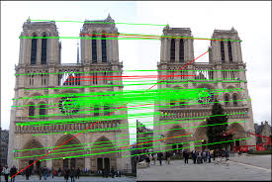
Overview
VIO techniques
VINS-Mono: Intro
Pre-processing
Initialization
VIO algorithm
Relocalization and Global pose graph optimization
Temporal calib
VIO: Feature Extraction and Tracking
Feature Tracking
Features present in 2 images are matched based on the descriptor details. This helps to map the transformation of the image and to estimate the average up-to scale movement between those 2 frames.
Several type of feature tracking algorithms are:
VINS-Mono uses KLT-optical flow as tracker
Descriptor matching
Filtering based
Optical flow tracking
Pixel processing
Explained above
Targeted area in current frame matched with most similar area in next frame
Kalman
Particle based
Mean-shift
Change in illumination of a region to estimate change in position
Difference
Phase based
Correlation
Block pixel matching

Slide 11
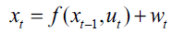
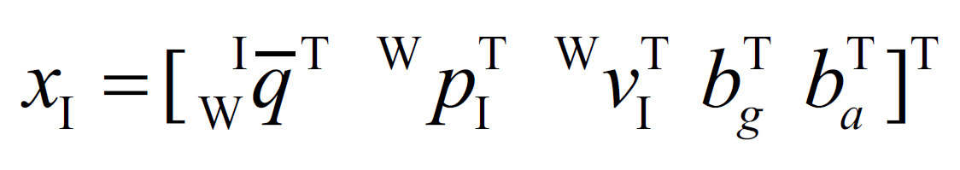
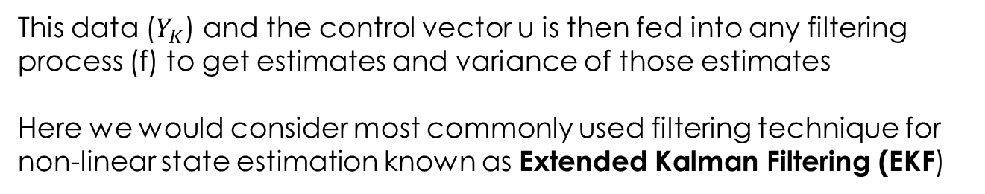
Overview
VIO techniques
VINS-Mono: Intro
Pre-processing
Initialization
VIO algorithm
Relocalization and Global pose graph optimization
Temporal calib
VIO: Dynamic Observational model
This serves as both control and state estimation of the filtering pipeline
Why? In real world, data arrives with a lag and has error associated to it
IMU data at any given point can be represented by a 16-dimensional vector
This data ($Y_{K}$) and the control vector u is then fed into any filtering process (f) to get estimates and variance of those estimates
Here we would consider most commonly used filtering technique for non-linear state estimation known as Extended Kalman Filtering (EKF)

Slide 12
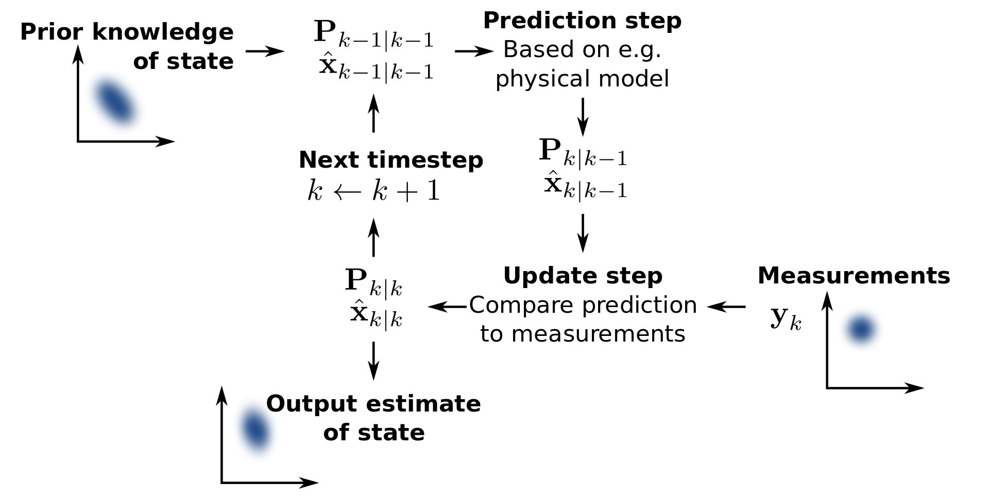
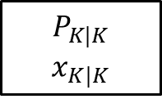
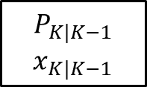
Overview
VIO techniques
VINS-Mono: Intro
Pre-processing
Initialization
VIO algorithm
Relocalization and Global pose graph optimization
Temporal calib
VIO: EKF based techniques
Extended Kalman Filter (EKF) is a non-linear Kalman filter which is used to fuse multiple sensor data and estimate state at any given time. Can also implement control system based on it
Why? In real world, data arrives with a lag and has error associated to it
$P_{K|K−1}$: Variance of (estimate at time k) calculated at time k-1
$x_{K|K−1}$: estimate at time k calculated at time k-1 $Y_{K}$: Reading at time k
Update Phase
$$P_{K|K−1}$$
$$x_{K|K−1}$$
$$P_{K|K}$$
$$x_{K|K}$$
@t = k-1
@t = k
Kalman Gain
Tuning gain gives us control on smoothness and responsiveness of system

Slide 13
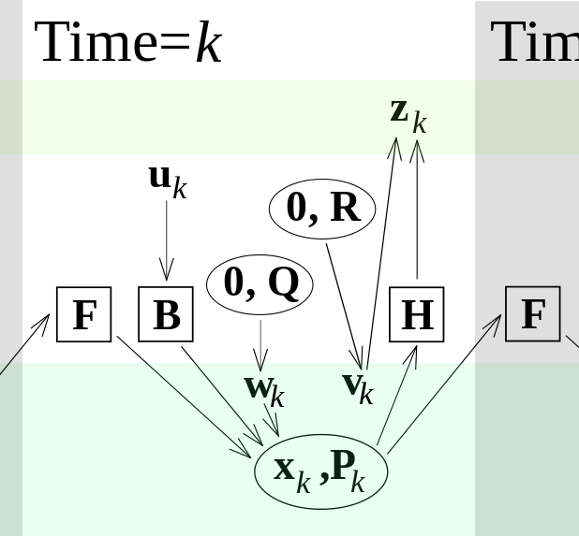
Overview
VIO techniques
VINS-Mono: Intro
Pre-processing
Initialization
VIO algorithm
Relocalization and Global pose graph optimization
Temporal calib
VIO: EKF based techniques
Extended Kalman Filter (EKF) is a non-linear Kalman filter which is used to fuse multiple sensor data and estimate state at any given time. Can also implement control system based on it
Prediction Phase
F : state transition model (takes input from previous state)
H : oberservation model (takes current estimate and converts them to estimated measurements)
Q : covariance process noise
R : covariance observation noise
B : Control input model

Slide 14
Overview
VIO techniques
VINS-Mono: Intro
Pre-processing
Initialization
VIO algorithm
Relocalization and Global pose graph optimization
Temporal calib
VIO: EKF based techniques
Extended Kalman Filter (EKF) is a non-linear Kalman filter which is used to fuse multiple sensor data and estimate state at any given time. Can also implement control system based on it
Complete process looks like this

Slide 15
VINS-Mono
Only important modules and their working

Slide 16
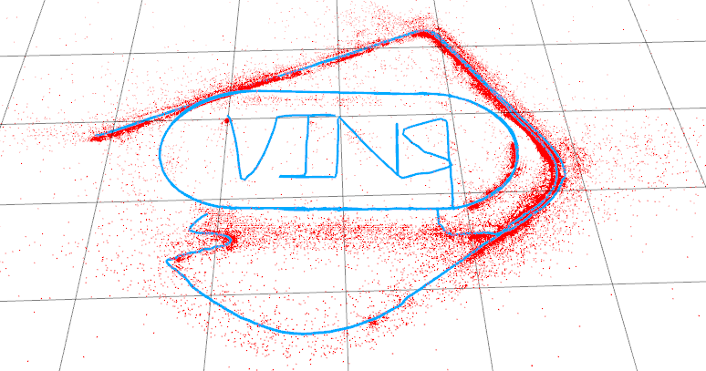
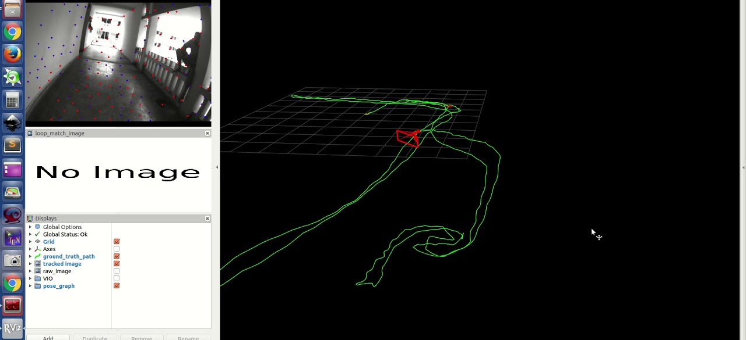
Overview
VIO techniques
VINS-Mono: Intro
Pre-processing
Initialization
VIO algorithm
Relocalization and Global pose graph optimization
Temporal calib
VINS-Mono: Introduction
State of the art tightly coupled non-linear optimization based SLAM
Tightly-coupled: unlike other loosely coupled filtering algorithms, here IMU-data is not only just to assist visual-based odometry but both visual features and IMU contribute equally to error optimization
Non-linear: The final optimization problem is of order 2 and thus makes it a non-linear problem
Optimization based: The estimated state prediction is not done using a filtering algorithm but reiterations of previous data to reach a convergence of minimum possible error and hence optimizing for it.
Infact, it has various modules which individually optimize their own errors and thus, multiple optimizations are running parallelly.

Slide 17
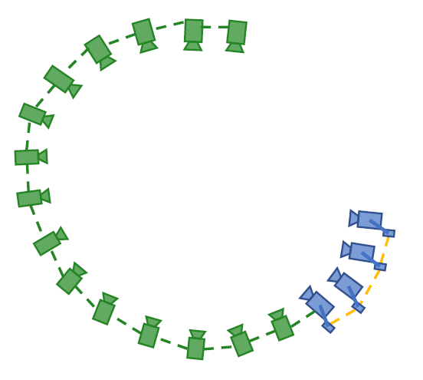
Overview
VIO techniques
VINS-Mono: Intro
Pre-processing
Initialization
VIO algorithm
Relocalization and Global pose graph optimization
Temporal calib
VINS-Mono: Introduction
Global v/s Local
Two sides of the story
Local odometry
Global odometry
What is happening locally
Optimizing for local odometry errors
Relation with previous few frames and using intermediate IMU data
What is global picture
Taking previously accumulated errors in account
Relation with frames acquired long time back and visiting same point again
SLIDING WINDOW
GLOBAL POSE GRAPH
As new data comes in sliding window, we push older data to priori pose graph

Slide 18
Overview
VIO techniques
VINS-Mono: Intro
Pre-processing
Initialization
VIO algorithm
Relocalization and Global pose graph optimization
Temporal calib
VINS-Mono: Introduction
Various modules in VINS
Camera
Initialization
or
Core-VIO
Pre-Processing
IMU data
First Data
Starting estimate
for Core-VIO
No initial estimate
Initialization
+ failure detection
New Data
Previous estimates
New estimates
Core-VIO algorithm
Adjustment for drift accumulated
Previously visited place
(Loop detected)
Relocalization + Pose graph Optimization
Adjusted local and global odometry data

Slide 19
Overview
VIO techniques
VINS-Mono: Intro
Pre-processing
Initialization
VIO algorithm
Relocalization and Global pose graph optimization
Temporal calib
VINS-Mono: Introduction
Various modules in VINS
Camera
Initialization
or
Core-VIO
Pre-Processing
IMU data
First Data
Starting estimate
for Core-VIO
No initial estimate
Initialization
+ failure detection
New Data
Previous estimates
New estimates
Core-VIO algorithm
Adjustment for drift accumulated
Previously visited place
(Loop detected)
Relocalization + Pose graph Optimization
Adjusted local and global odometry data

Slide 20
Overview
VIO techniques
VINS-Mono: Intro
Pre-processing
Initialization
VIO algorithm
Relocalization and Global pose graph optimization
Temporal calib
VINS-Mono: Introduction
Various modules in VINS
Camera
Initialization
or
Core-VIO
Pre-Processing
IMU data
First Data
Starting estimate
for Core-VIO
No initial estimate
Initialization
+ failure detection
New Data
Previous estimates
New estimates
Core-VIO algorithm
Adjustment for drift accumulated
Previously visited place
(Loop detected)
Relocalization + Pose graph Optimization
Adjusted local and global odometry data

Slide 21
Overview
VIO techniques
VINS-Mono: Intro
Pre-processing
Initialization
VIO algorithm
Relocalization and Global pose graph optimization
Temporal calib
VINS-Mono: Introduction
Various modules in VINS
Camera
Initialization
or
Core-VIO
Pre-Processing
IMU data
First Data
Starting estimate
for Core-VIO
No initial estimate
Initialization
+ failure detection
New Data
Previous estimates
New estimates
Core-VIO algorithm
Adjustment for drift accumulated
Previously visited place
(Loop detected)
Relocalization + Pose graph Optimization
Adjusted local and global odometry data

Slide 22
Overview
VIO techniques
VINS-Mono: Intro
Pre-processing
Initialization
VIO algorithm
Relocalization and Global pose graph optimization
Temporal calib
VINS-Mono: Introduction
Pre-processing
Key-point selection
Feature detection and Tracking
Camera
Key-point Tracking
IMU data
IMU Pre-integration
IMU bias estimation
and parameterization
VISION PRE-PROCESSING
Feature Detection: BRIEF descriptor (rotational in-variant)
Feature Tracking: KLT sparse optical flow
Keypoint Outlier rejection: RANSAC + uniform spatial distance between keypoints
Keyframe selection: average parallax from previous keyframe more than threshold. Any image not a keyframe is thrown and only IMU data kept.

Slide 23
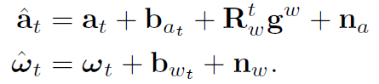
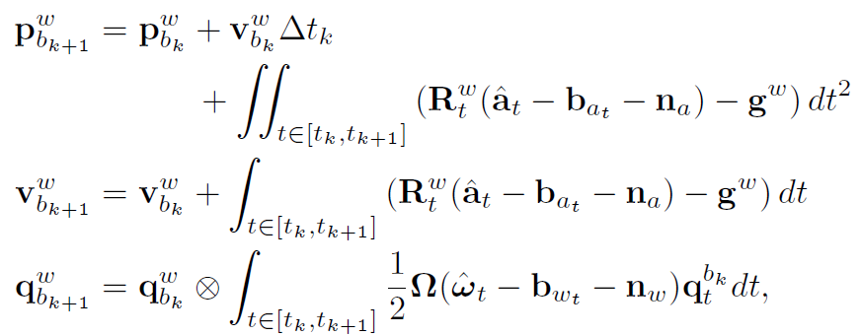
Overview
VIO techniques
VINS-Mono: Intro
Pre-processing
Initialization
VIO algorithm
Relocalization and Global pose graph optimization
Temporal calib
VINS-Mono: Introduction
Pre-processing
IMU PRE-INTEGRATION
Why is it required
What happens in this process
Mathematical Formulation
Accelerometer and Gyroscopic measurements from IMU
Translation vector, Velocity vector and Rotation vector from body frame to world frame

Slide 24
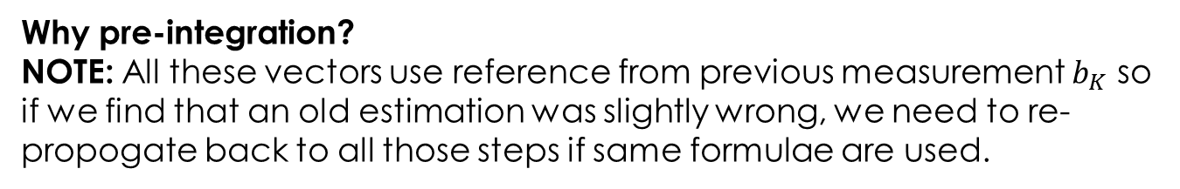
Overview
VIO techniques
VINS-Mono: Intro
Pre-processing
Initialization
VIO algorithm
Relocalization and Global pose graph optimization
Temporal calib
VINS-Mono: Introduction
Pre-processing
Why pre-integration?
NOTE: All these vectors use reference from previous measurement $b_{K}$ so if we find that an old estimation was slightly wrong, we need to re-propogate back to all those steps if same formulae are used.
Accelerometer and Gyroscopic measurements from IMU
Translation vector, Velocity vector and Rotation vector from body frame to world frame

Slide 25
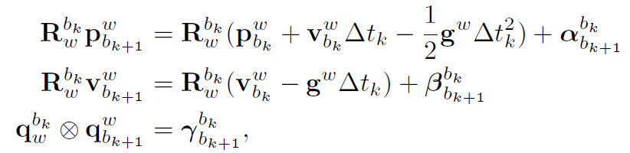
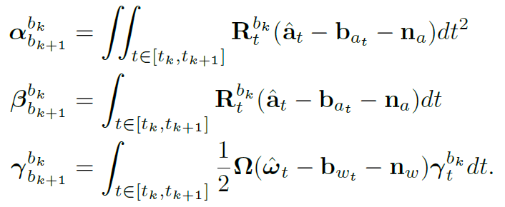
Overview
VIO techniques
VINS-Mono: Intro
Pre-processing
Initialization
VIO algorithm
Relocalization and Global pose graph optimization
Temporal calib
VINS-Mono: Introduction
Pre-processing
New vector estimates which do not directly use previous measurements
Changing from world to body frame:
Here, α (alpha), β (beta), γ (gamma) only depend on bias and not on any previous state
So whenever out bias estimate changes, we can adjust only these parameters by first derivative of change or re-iterate them if error is large

Slide 26
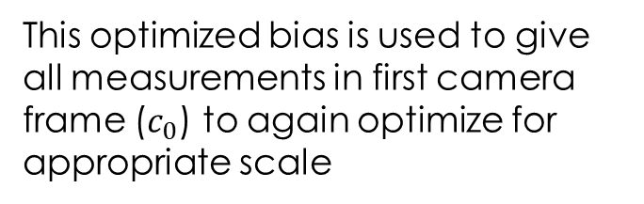
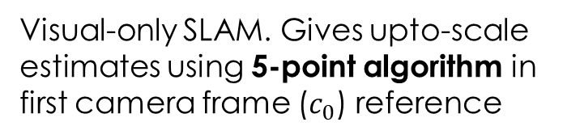
Overview
VIO techniques
VINS-Mono: Intro
Pre-processing
Initialization
VIO algorithm
Relocalization and Global pose graph optimization
Temporal calib
VINS-Mono: Initialization
Why important?
We want an initial estimation of motion and scale relation from IMU but it has large bias which may lead to larger error later in SLAM
How is it done?
Structure from Motion (SfM)
Visual-Inertial Alignment
Visual-only SLAM. Gives upto-scale estimates using 5-point algorithm in first camera frame ($c_{0}$) reference
Optimizes rotation error between two consecutive frames to give gyroscopic bias estimation (alpha,beta,gamma)
This optimized bias is used to give all measurements in first camera frame ($c_{0}$) to again optimize for appropriate scale

Slide 27

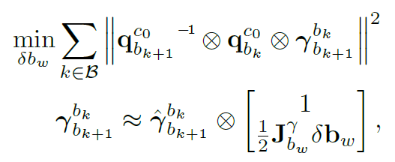
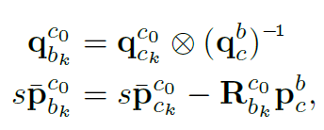
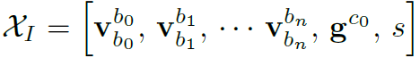
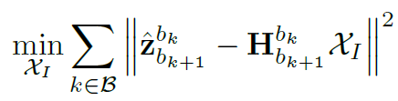
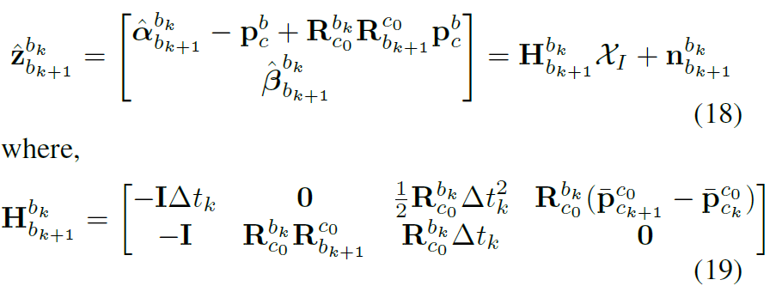
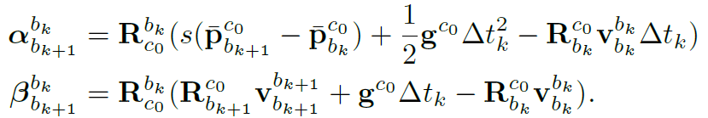
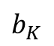
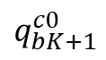
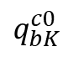
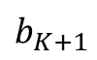
Overview
VIO techniques
VINS-Mono: Intro
Pre-processing
Initialization
VIO algorithm
Relocalization and Global pose graph optimization
Temporal calib
VINS-Mono: Initialization
$$b_{K}$$
$$b_{K+1}$$
Error optimization cost for bias estimation
$$q_{bK}^{c0}$$
$$q_{bK+1}^{c0}$$
From SfM
From IMU pre-integration
Once we have IMU bias estimation, we plug it in this equation to minimize another scale associated error
Equation governing translation and rotation in camera frame
Requires scale and IMU bias

Slide 28

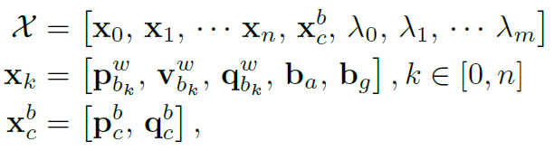
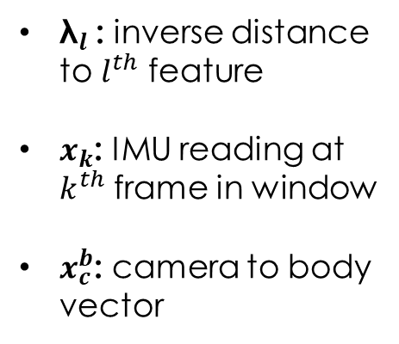
Overview
VIO techniques
VINS-Mono: Intro
Pre-processing
Initialization
VIO algorithm
Relocalization and Global pose graph optimization
Temporal calib
VINS-Mono: VIO-core
Priori
Sliding Window
This module works only on Sliding Window part
State vector in sliding window can be represented as:
${\text{λ}}_{l}$: inverse distance to $l^{th}$ feature
$x_{k}$: IMU reading at $k^{th}$ frame in window
$x_{c}^{b}$: camera to body vector

Slide 29
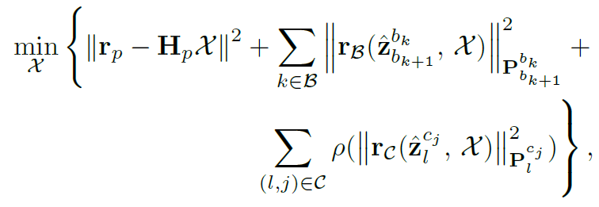
Overview
VIO techniques
VINS-Mono: Intro
Pre-processing
Initialization
VIO algorithm
Relocalization and Global pose graph optimization
Temporal calib
VINS-Mono: VIO-core
Optimization function to be satisfied at each timestep
IMU residual error
Visual measurement residual error
Error due to prior information
State vector in sliding window can be represented as:
${\text{λ}}_{l}$: inverse distance to $l^{th}$ feature
$x_{k}$: IMU reading at $k^{th}$ frame in window
$x_{c}^{b}$: camera to body vector

Slide 30
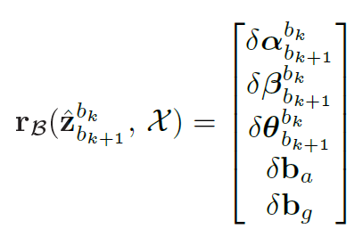
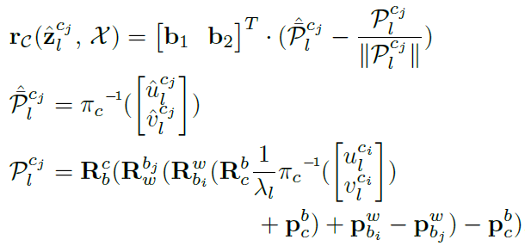
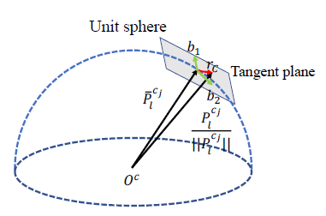
Overview
VIO techniques
VINS-Mono: Intro
Pre-processing
Initialization
VIO algorithm
Relocalization and Global pose graph optimization
Temporal calib
VINS-Mono: VIO-core
IMU residual error
Visual Measurement residual error
Observed
Change in IMU states and bias estimates from previous frame to this frame by pre-integration step
Expected
What does it all mean?
It is just the scaled camera reprojection error of a feature
Error = Scale*(expected reprojection – true)
P : unit vector along reprojection

Slide 31
Overview
VIO techniques
VINS-Mono: Intro
Pre-processing
Initialization
VIO algorithm
Relocalization and Global pose graph optimization
Temporal calib
VINS-Mono: VIO-core
Marginalization: Process of converting older sliding window data to priori
Keyframe
Priori
marginalized
Sliding Window
If second latest image not a keyframe: its image data is thrown and only IMU kept. No frame marginalized
If second latest image is a keyframe: oldest frame in sliding window marginalized (converted to priori)
AIM: Keep latest and spatially separated keyframes in the window
Failure Detection and Bundle Adjustment

Slide 32
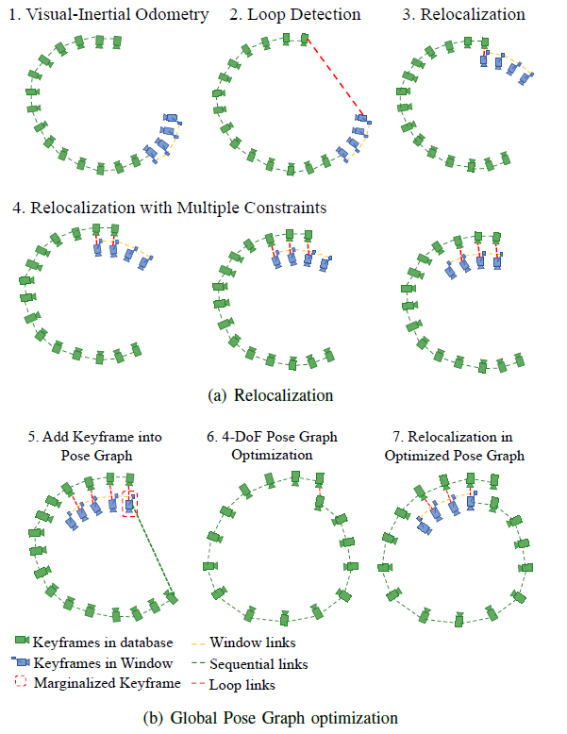
Overview
VIO techniques
VINS-Mono: Intro
Pre-processing
Initialization
VIO algorithm
Relocalization and Global pose graph optimization
Temporal calib
VINS-Mono: Relocalization
Relocalization and Global Pose Graph optimization only occur when we visit a previously visited location (Loop closure)
Every effort is made to minimize error but still some drift occurs. When we visit a location again, our past knowledge and current position can help us correct for those drifts. Correcting those drifts in sliding window is Relocalization and thereby adjusting previous data according to it is Global pose graph optimization

Slide 33
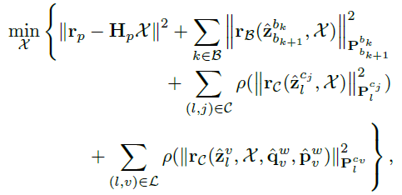
Overview
VIO techniques
VINS-Mono: Intro
Pre-processing
Initialization
VIO algorithm
Relocalization and Global pose graph optimization
Temporal calib
VINS-Mono: Relocalization
Relocalization has 2 steps:
Loop detection: DBoW2 (Database Bag of Words representation of image features indexed for fast retrieval)
Optimization
$l^{th}$ feature observed previously in $v^{th}$ frame
Hence apart from usual cost function for sliding window, we now have a term which constraints us with loop connections to give us new estimated state and thus minimizing the overall drift.

Slide 34
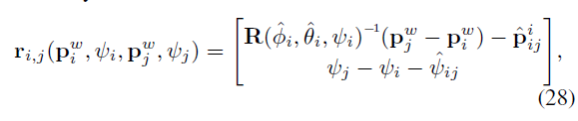
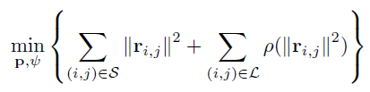
Overview
VIO techniques
VINS-Mono: Intro
Pre-processing
Initialization
VIO algorithm
Relocalization and Global pose graph optimization
Temporal calib
VINS-Mono: Global Pose graph
As we have already relocalized the sliding window, the pose graph looks like image 5
4-Dof pose graph optimization:
Done according to sequential and loop closure edges residual error
Pose Graph
Sequential edges
Loop edges

Slide 35
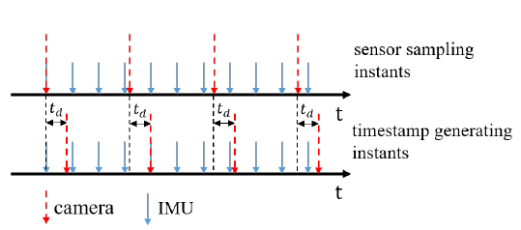
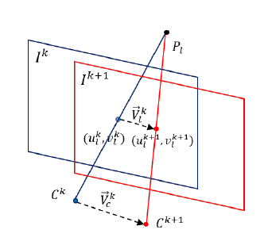
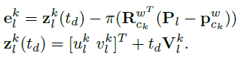
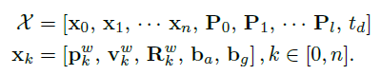
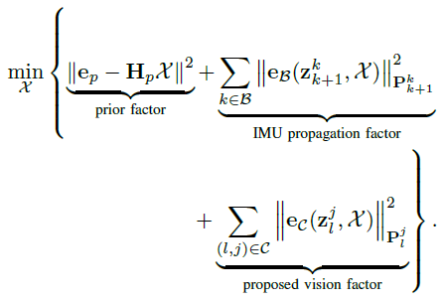
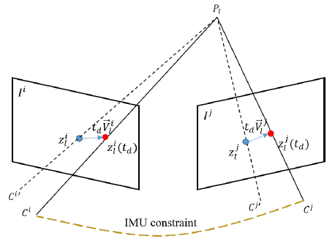

Overview
VIO techniques
VINS-Mono: Intro
Pre-processing
Initialization
VIO algorithm
Relocalization and Global pose graph optimization
Temporal calib.
Temporal Calibration
IMU and camera measurement don’t arrive at the same time, hence an estimate of time delay ($t_{d}$) is required
Expected location of feature considering time delay
New state function
Using same optimization cost function as before but with a newer state function

Slide 36

Overview
VIO techniques
VINS-Mono: Intro
Pre-processing
Initialization
VIO algorithm
Relocalization and Global pose graph optimization
Temporal calib.
VINS-Mono: Working
Every /Scene data goes to /feature_tracker (pre-processing) and /pose_graph (detect loop closure)
If any matched points from previous poses, /pose_graph gives it to /vins_estimator (VIO-core) to optimize for it by channel /match_points
All marginalized keyframes are saved in /pose_graph by channel /keyframe_pose
Currently, we have set VINS to receive IMU data from mavros (can be made to take from airsim too)
Feature tracker tells /vins_estimator to restart if it looses track by a separate channel /feature_tracker/restart

Slide 37
Thanking you

